Slide 1

Intro to object-oriented programming
Chapter 5 – Introduction to pygame

Slide 2
Itroduction to pygame
The Python language was designed to handle text input and text output. It provides the ability to get text from and send text to the user, a file, and the internet. The core language, however, has no way of dealing with more modern concepts such as windows, mouse clicks, sounds, and so on. So, what if you want to use Python to create something more state-of-the-art than a text-based program?
In this chapter I’ll introduce pygame, a free open source external package that was designed to extend Python to allow programmers to build game programs. You can also use pygame to build other kinds of interactive programs with a graphical user interface (GUI). It adds the ability to create windows, show images, recognize mouse movements and clicks, play sounds, and more. In short, it allows Python programmers to build the types of games and applications that current computer users have become familiar with.
It is not my intent to turn you all into game programmers—even though that might be a fun outcome. Rather, I’ll use the pygame environment to make certain object-oriented programming techniques clearer and more visual. By working with pygame to make objects visible in a window and dealing with a user interacting with those objects, you should gain a deeper understanding of how to effectively use OOP techniques. This chapter provides a general introduction to pygame, so most of the information and examples in this chapter will use procedural coding. Starting with the next chapter, I will explain how to use OOP effectively with pygame

Slide 3
Installing Pygame
Pygame is a free downloadable package. We’ll use the package manager pip (short for pip installs packages) to install Python packages
python3 -m pip install -U pip –user
import pygame to test the package
If you see a message saying something like “Hello from the pygame community” or if you get no message at all, then pygame has been installed correctly. The lack of an error message indicates that Python has been able to find and load the pygame package and it’s ready to use. If you would like to see a sample game using pygame, enter the following command (which starts a version of Space Invaders):
python3 -m pygame.examples.aliens
Before we get into using pygame, I need to explain two important concepts. First, I’ll explain how individual pixels are addressed in programs that use a GUI. Then, I’ll discuss event-driven programs and how they differ from typical text-based programs. After that, we’ll code a few programs that demonstrate key pygame features.

Slide 4
Window Details
A computer screen is made up of a large number of rows and columns of small dots called pixels (from the words picture element). A user interacts with a GUI program through one or more windows; each window is a rectangular portion of the screen. Programs can control the color of any individual pixel in their window(s). If you’re running multiple GUI programs, each program is typically displayed in its own window. In this section, I’ll discuss how you address and alter individual pixels in a window. These concepts are independent of Python; they are common to all computers and are used in all programming languages

Slide 5
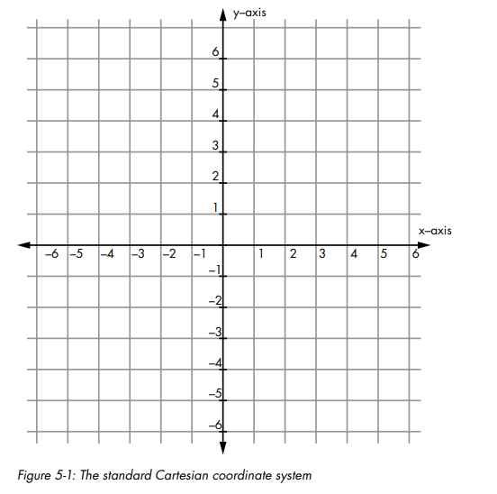
The Window Coordinate System
You are probably familiar with Cartesian coordinates in a grid like Figure 5-1. Any point in a Cartesian grid can be located by specifying its x- and y-coordinates (in that order). The origin is the point specified as (0, 0) and is found in the center of the grid.

Slide 6
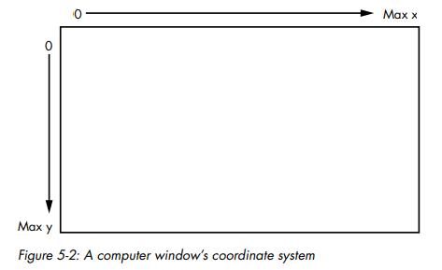
THE WINDOW COORDINATE SYSTEM
Computer window coordinates work in a similar way (Figure 5-2).
However, there are a few key differences:
1. The origin (0, 0) point is in the upper-left corner of the window.
2. The y-axis is reversed so that y values start at zero at the top of the window and increase as you go down.
3. The x and y values are always integers. Each (x, y) pair specifies a single pixel in the window. These values are always specified as relative to the upper-left corner of the window, not the screen. That way, the user can move the window anywhere on the screen without affecting the coordinates of the elements of the program displayed in the window
The full computer screen has its own set of (x, y) coordinates for every pixel and uses the same type of coordinate system, but programs rarely, if ever, need to deal with screen coordinates

Slide 7
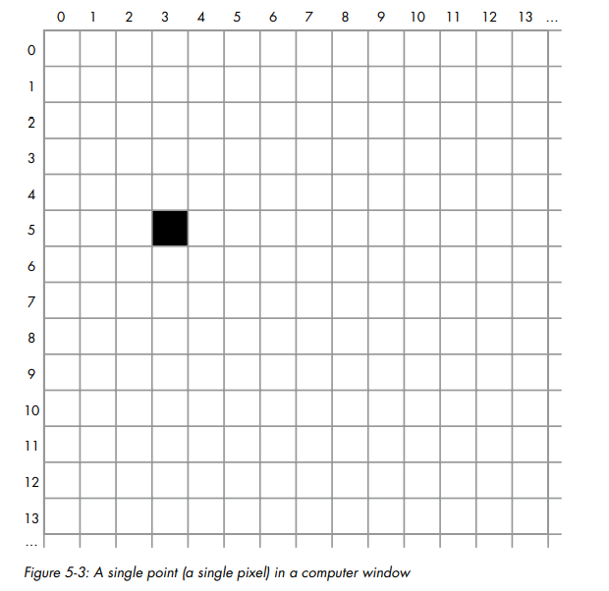
THE WINDOW COORDINATE SYSTEM
When we write a pygame application, we need to specify the width and height of the window we want to create. Within the window, we can address any pixel using its x- and y-coordinates, as shown in Figure 5-3.
Figure 5-3 shows a black pixel at position (3, 5). That is an x-value of 3 (note that this is actually the fourth column, since coordinates start at 0) and a y value of 5 (actually the sixth row). Each pixel in a window is commonly referred to as a point. To reference a point in a window, you would typically use a Python tuple. For example, you might have an assignment statement like this, with the x value first:
PixelLocation = (3, 5)

Slide 8
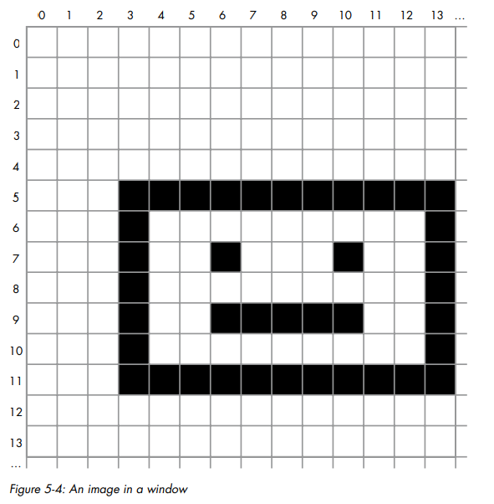
The Window Coordinate System
To show an image in a window, we need to specify the coordinates of its starting point—always the upper-left corner of the image—as an (x, y) pair, as in Figure 5-4, where we draw the image at location (3, 5).
When working with an image, you’ll often need to deal with the bounding rectangle, which is the smallest rectangle that can be made that completely surrounds all pixels of the image. A rectangle is represented in pygame by a set of four values: x, y, width, height. The rectangle for the image in Figure 5-4 has values of 3, 5, 11, 7. I’ll show you how to use a rectangle like this in an upcoming example program. Even if your image is not rectangular (for example, if it’s a circle or an ellipse), you still have to consider its bounding rectangle for positioning and collision detection

Slide 9

Pixel Colors
Let’s explore how colors are represented on the computer screen. If you have experience with a graphics program like Photoshop, you probably already know how this works, but you may want a quick refresher anyway.
Each pixel on the screen is made up of a combination of three colors: red, green, and blue, often referred to as RGB. The color displayed in any pixel is composed of some amount of red, green, and blue, where the amount of each is specified as a value from 0, meaning none, to 255, meaning full intensity. Therefore, there are 256 × 256 × 256 possible combinations, or 16,777,216 (often referred to as just “16 million”) possible colors, for each pixel.
Colors in pygame are given as RGB values, and we write them as Python tuples of three numbers. Here is how we create constants for the main colors:

Slide 10
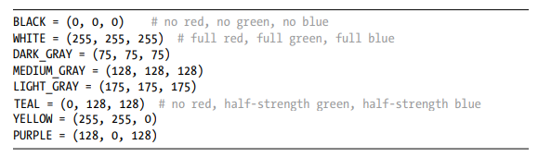
PIXEL COLORS
Here are the definitions of a few more colors. You can create a color using any combination of three numbers between 0 and 255:
In pygame, you’ll need to specify colors when you want to fill the background of a window, draw a shape in a color, draw text in a color, and so on. Defining colors up front as tuple constants makes them very easy to spot later in code

Slide 11
Event-Driven Programs
In most of the programs in the book so far, the main code has lived in a while loop. The program stops at a call to the built-in input() function and waits for some user input to work on. Program output is typically handled using calls to print().
In interactive GUI programs, this model no longer works. GUIs introduce a new model of computing known as the event-driven model. Event-driven programs don’t rely on input() and print(); instead, the user interacts with elements in a window at will using a keyboard and/or mouse or other pointing device. They may be able to click various buttons or icons, make selections from menus, provide input in text fields, or give commands via clicks or key presses to control some avatar in the window.
Central to event-driven programming is the concept of an event. Events are difficult to define and are best described with examples, such as a mouse click and a key press (each of which is actually made up of two events: mouse down and mouse up and key down and key up, respectively).
An event-driven GUI program runs constantly in an infinite loop. Each time through the loop, the program checks for any new events it needs to react to and executes appropriate code to handle those events. Also, each time through the loop, the program needs to redraw all the elements in the window to update what the user sees.

Slide 12
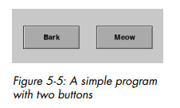
EVENT-DRIVEN PROGRAMS
For example, say we have a simple GUI program that displays two buttons: Bark and Meow. When clicked, the Bark button plays a sound of a dog barking and the Meow button plays a sound of a cat meowing
The user can click these buttons in any order and at any time. To handle the user’s actions, the program runs in a loop and constantly checks to see if either button has been clicked. When it receives a mouse down event on a button, the program remembers that the button has been clicked and draws the depressed image of that button. When it receives a mouse up event on the button, it remembers the new state and redraws the button with its original appearance, and it plays the appropriate sound. Because the main loop runs so quickly, the user perceives that the sound plays immediately after they click the button. Each time through the loop, the program redraws both buttons with an image matching each button’s current state.

Slide 13
Using Pygame
At first, pygame may seem like an overwhelmingly large package with many different calls available. Although it is large, there’s actually not a lot that you need to understand to get a small program up and running. To introduce pygame, I’ll first give you a template that you can use for all pygame programs you create. Then I’ll build on that template, adding key pieces of functionality little by little:
Bring up a blank window.
Show an image.
Detect a mouse click.
Detect both single and continuous key presses.
Create a simple animation.
Play sound effects and background sounds.
Draw shapes.
In the next chapter, we’ll continue the discussion of pygame and you’ll see how to:
Animate many objects.
Build and react to a button.
Create a text display field.

Slide 14
Bringing Up a Blank Window
As I said earlier, pygame programs run constantly in a loop, checking for events. It might help to think of your program as an animation, where each pass through the main loop is one frame. The user may click on something during any frame, and your program must not only respond to that input but also keep track of everything it needs to draw in the window. For instance, in one example program later in this chapter, we’ll move a ball across the window so in each frame the ball is drawn in a slightly different position.
EXAMPLE is a generic template that you can use as a starting point for all your pygame programs. This program opens a window and paints the entire contents black. The only thing the user can do is click the close button to quit the program.
EXAMPLE: A template for creating pygame programs

Slide 15
BRINGING UP A BLANK WINDOW
Let’s walk through the different parts of this template:
1. Import packages.
The template starts with the import statements. We first import the pygame package itself, then some constants defined inside pygame that we’ll use later. The last import is the sys package, which we’ll use to quit our program.
2. Define constants.
We next define any constants for our program. First we define the RGB value for BLACK, which we will use to paint the background of our window. Then we define constants for the width and height of our window in pixels and a constant for the refresh rate for our program. This number defines the maximum number of times the program will loop (and therefore redraw the window) per second. Our value of 30 is fairly typical. If the amount of work done in our main loop is excessive, the program might run slower than this value, but it will never run faster. A refresh rate that’s too high might cause the program to run too fast. In our ball example, this means the ball might bounce around the window faster than intended.
3. Initialize the pygame environment.
In this section, we call a function that tells pygame to initialize itself. We then ask pygame to create a window for our program with the pygame.display.set_mode() function and pass in the desired width and height of the window. Finally, we call another pygame function to create a clock object, which will be used at the bottom of our main loop to maintain our maximum frame rate.

Slide 16
BRINGING UP A BLANK WINDOW
4. Load assets:
image(s), sound(s), and so on. This is a placeholder section, into which we will eventually add code to load external images, sounds, and so on from the disk for use in our program. In this basic program we’re not using any external assets, so this section is empty for now
5. Initialize variables.
Here we will eventually initialize any variables that our program will use. Currently we have none, so we have no code here
6. Loop forever.
Here we start our main loop. This is a simple while True infinite loop. Again, you can think of each iteration through the main loop as one frame in an animation.
7. Check for and handle events; commonly referred to as the event loop.
In this section, we call pygame.event.get() to get a list of the events that happened since the last time we checked (the last time the main loop ran), then iterate through the list of events. Each event reported to the program is an object, and every event object has a type. If no event has happened, this section is skipped over. In this minimal program, where the only action a user can take is to close the window, the only event type we check for is the constant pygame.QUIT, generated by pygame when the user clicks the close button. If we find this event, we tell pygame to quit, which frees up any resources it was using. Then we quit our program.

Slide 17
BRINGING UP A BLANK WINDOW
8. Do any “per frame” actions.
In this section we’ll eventually put any code that needs to run in every frame. This might involve moving things in the window or checking for collisions between elements. In this minimal program, we have nothing to do here
9. Clear the window.
On each iteration through the main loop, our program must redraw everything in the window, which means we need to clear it first. The simplest approach is to just fill the window with a color, which we do here with a call to window.fill(), specifying a black background. We could also draw a background picture, but we’ll hold off on that for now.
10. Draw all window elements.
Here we’ll place code to draw everything we want to show in our window. In this sample program there is nothing to draw. In real programs, things are drawn in the order they appear in the code, in layers from backmost to frontmost. For example, assume we want to draw two partially overlapping circles, A and B. If we draw A first, A will appear behind B, and portions of A will be obscured by B. If we draw B first and then A, the opposite happens, and we see A in front of B. This is a natural mapping equivalent to the layers in graphics programs such as Photoshop.

Slide 18
BRINGING UP A BLANK WINDOW
11. Update the window.
This line tells pygame to take all the drawing we’ve included and show it in the window. Pygame actually does all the drawing in steps 8, 9, and 10 in an off-screen buffer. When you tell pygame to update, it takes the contents of this off-screen buffer and puts them in the real window
12. Slow things down a bit.
Computers are very fast, and if the loop continued to the next iteration right away without pausing, the program might run faster than the designated frame rate. The line in this section tells pygame to wait until a given amount of time has elapsed in order to make the frames of our program run at the frame rate that we specified. This is important to ensure the program runs at a consistent rate, independent of the speed of the computer on which it’s running.
When you run this program, the program just puts up a blank window filled with black. To end the program, click on the close button in the title bar.

Slide 19
Drawing an Image
Let’s draw something in the window. There are two parts to showing a graphic image: first we load the image into the computer’s memory, then we display the image in the application window
With pygame, all images (and sounds) need to be kept in files external to your code. Pygame supports many standard graphic file formats, including .png, .jpg, and .gif. In this program we’ll load a picture of a ball from the file ball.png
While we only need one graphic file in this program, it’s a good idea to use a consistent approach to handling graphic and sound files, so I’ll lay one out for you here. First, create a project folder. Place your main program in that folder, along with any related files containing Python classes and functions. Then, inside the project folder, create an images folder into which you’ll place any image files you want to use in your program. Also create a sounds folder and place any sound files you want to use there.

Slide 20
Drawing an image
A path (also called a pathname) is a string that uniquely identifies the location of a file or folder on a computer. To load a graphic or sound file into your program, you must specify the path to the file. There are two types of paths: relative and absolute. A relative path is a relative to the current folder, often called the current working directory. When you run a program using an IDE such as IDLE or PyCharm, it sets the current folder to the one containing your main Python program so you can use relative paths with ease.
The relative path for a graphic file (for example, ball.png) in the same folder as your main Python file would be just the filename as a string (for example, 'ball.png'). Using the suggested project structure, the relative path would be 'images/ball.png'. This says that inside the project folder will be another folder named images, and inside that folder is a file named ball.png. In path strings, folder names are separated by the slash character.
However, if you expect to run your program from the command line, then you need to construct absolute paths for all files. An absolute path is one that starts from the root of the filesystem and includes the full hierarchy of folders to your file. We will not use an absolute path for this program for now.
Now we’ll create the code of the ball program, starting with the earlier 12-step template and adding just two new lines of code
EXAMPLE: Load one image and draw it in every frame.

Slide 21
DRAWING AN IMAGE
First, we tell pygame to find the file containing the image of the ball and load that image into memory. The variable ballImage now refers to the image of the ball. Notice that this assignment statement is only executed once, before the main loop starts.
We then tell the program to draw the ball every time we go through the main loop. We specify the location representing the position to place the upper-left corner of the image’s bounding rectangle, typically as a tuple of x- and y-coordinates.
The function name blit() is a very old reference to the words bit block transfer, but in this context it really just means “draw.” Since the program loaded the ball image earlier, pygame knows how big the image is, so we just need to tell it where to draw the ball. In EXAMPLE, we give an x value of 100 and a y value of 200. When you run the program, on each iteration through the loop (30 times per second) every pixel in the window is set to black, then the ball is drawn over the background. From the user’s point of view, it looks like nothing is happening—the ball just stays in one spot with the upper-left corner of its bounding rectangle at location (100, 200).

Slide 22
Detecting a Mouse Click
Next, we’ll allow our program to detect and react to a mouse click. The user will be able to click on the ball to make it appear somewhere else in the window. When the program detects a mouse click on the ball, it randomly picks new coordinates and draws the ball at that new location. Instead of using hardcoded coordinates of (100, 200), we’ll create two variables, ballX and ballY, and refer to the coordinates of the ball in the window as the tuple (ballX, ballY)
EXAMPLE: Detecting a mouse click and acting on it

Slide 23
Handling the Keyboard
The next step is to allow the user to control some aspect of the program through the keyboard. There are two different ways to handle user keyboard interactions: as individual key presses, and when a user holds down a key to indicate that an action should happen for as long as that key is down (known as continuous mode).
Recognizing Individual Key Presses: Like the mouse clicks, each key press generates two events: key down and key up. The two events have different event types: pygame.KEYDOWN and pygame.KEYUP.
EXAMPLE shows a small sample program that allows the user to move the ball image in the window using the keyboard. The program also shows a target rectangle in the window. The user’s goal is to move the ball image so that it overlaps with the target image.
EXAMPLE: Detecting and acting on single key presses

Slide 24
Dealing with Repeating Keys in Continuous Mode
The second way to handle keyboard interactions in pygame is to poll the keyboard. This involves asking pygame for a list representing which keys are currently down in every frame
EXAMPLE: Handling keys being held down

Slide 25
Creating a Location-Based Animation
Next, we’ll build a location-based animation. This code will allow us to move an image diagonally and then have it appear to bounce off the edges of the window. This was a favorite technique of screensavers on old CRTbased monitors, to avoid burning in a static image.
We’ll change the location of our image slightly in every frame. We’ll also check if the result of that movement would place any part of the image outside one of the window boundaries and, if so, reverse the movement in that direction. For example, if the image was moving down and would cross the bottom of the window, we would reverse the direction and make the image start moving up.
We’ll again use the same starting template
EXAMPLE: A location-based animation, bouncing a ball around the window

Slide 26
Creating a Location-Based Animation
We start by creating and initializing the two variables xSpeed and ySpeed, which determine how far and in what direction the image should move in each frame. We initialize both variables to the number of pixels to move per frame (3), so the image will start by moving three pixels to the right (the positive x direction) and three pixels down (the positive y direction).
In the key part of the program, we handle the x- and y-coordinates separately. First, we check to see if the x-coordinate of the ball is less than zero, meaning that part of the image is off the left edge, or past the MAX_WIDTH pixel and so effectively off the right edge. If either of these is the case, we reverse the sign of the speed in the x direction, meaning it will go in the opposite direction. For example, if the ball was moving to the right and went off the right edge, we would change the value of xSpeed from 3 to –3 to cause the ball to start moving to the left, and vice versa.
Then we do a similar check for the y-coordinate to make the ball bounce off the top or bottom edge, as needed.
Finally, we update the position of the ball by adding the xSpeed to the ballX coordinate and adding the ySpeed to the ballY coordinate 3. This positions the ball at a new location on both axes.
At the bottom of the main loop, we draw the ball. Since we’re updating the values of ballX and ballY in every frame, the ball appears to animate smoothly. Try it out. Whenever the ball reaches any edge, it seems to bounce off.

Slide 27
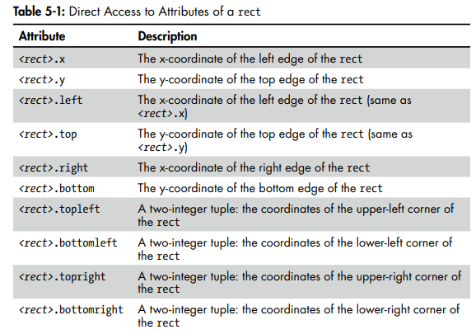
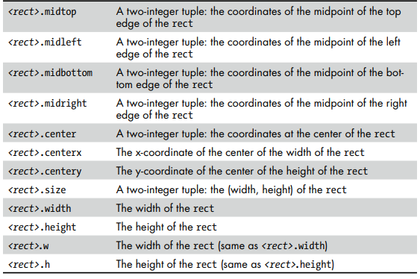
Using Pygame rects
Next I’ll present a different way to achieve the same result. Rather than keeping track of the current x- and y-coordinates of the ball in separate variables, we’ll use the rect of the ball, update the rect every frame, and check if performing the update would cause any part of the rect to move outside an edge of the window. This results in fewer variables, and because we’ll start by making a call to get the rect of an image, it will work with images of any size. When you create a rect object, in addition to remembering the left, top, width, and height as attributes of the rectangle, that object also calculates and maintains a number of other attributes for you.
You can access any of these attributes directly by name using dot syntax, as shown in Table 5-1

Slide 28
USING PYGAME RECTS
A pygame rect also can be thought of, and accessed as, a list of four elements. Specifically, you can use an index to get or set any individual part of a rect. For instance, using the ballRect, the individual elements can be accessed as:
ballRect[0] is the x value (but you could also use ballRect.left)
ballRect[1] is the y value (but you could also use ballRect.top)
ballRect[2] is the width (but you could also use ballRect.width)
ballRect[3] is the height (but you could also use ballRect.height)

Slide 29
USING PYGAME RECTS
EXAMPLE: A location-based animation, bouncing a ball around the window, using rects
This approach of using a rect object is neither better nor worse than using separate variables. The resulting program works exactly the same as the original. The important lesson here is how you can use and manipulate attributes of a rect object
After loading the image of the ball, we call the get_rect() method to get the bounding rectangle of the image. That call returns a rect object, which we store into a variable called ballRect. We use ballRect.width and ballRect.height to get direct access to the width and height of the ball image. (In the previous version, we used a constant of 100 for the width and the height.) Getting these values from the image that was loaded makes our code much more adaptable because it means we can use a graphic of any size.
The code also uses the attributes of the rectangle rather than using separate variables for checking if any part of the ball’s rectangle goes over an edge. We can use ballRect.left and ballRect.right to see if the ballRect is off the left or right edges. We do a similar test with ballRect.top and ballRect.bottom. Rather than updating individual x- and y-coordinate variables, we update the left and top of the ballRect.
The other subtle but important change is in the call to draw the ball. The second argument in the call to blit() can be either an (x, y) tuple or a rect. The code inside blit() uses the left and top position in the rect as the x- and y-coordinates.

Slide 30

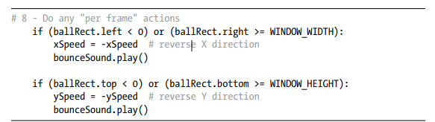
Playing Sounds
There are two types of sounds that you might want to play in your programs: short sound effects and background music.
All sound effects must live in external files and must be in either .wav or .ogg format. Playing a relatively short sound effect consists of two steps: load the sound from an external sound file once; then at the appropriate time(s) play your sound.
We’ll modify EXAMPLE to add a “boing” sound effect whenever the ball bounces off a side of the window. There is a sounds folder in the project folder at the same level as the main program. Right after loading the ball image, we load the sound file by adding this code:
To play the “boing” sound effect whenever we change either the horizontal or vertical direction of the ball, we modify section #8 to look like this

Slide 31
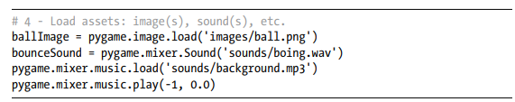
Playing Background Music
Playing background music involves two lines of code using calls to the pygame.mixer.music module. First, you need this to load the sound file into memory:
The <path to sounds file> is a path string where the sound file can be found. You can use .mp3 files, which seem to work best, as well as .wav or .ogg files. When you want to start the music playing, you need to make this call:
To play some background music repeatedly, you can pass in a -1 for <number of loops> to run the music forever. The <starting position> is typically set to 0 to indicate that you want to play the sound from the beginning. There is a downloadable, modified version of the bouncing ball program that properly loads the sound effect and background music files and starts the background sound playing. The only changes are in section #4, as shown here.

Slide 32
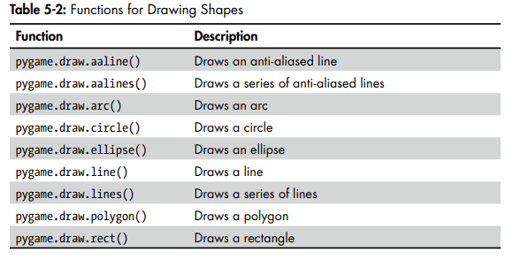
Drawing Shapes
Pygame offers a number of built-in functions that allow you to draw certain shapes known as primitives, which include lines, circles, ellipses, arcs, polygons, and rectangles. Table 5-2 provides a list of these functions.
Note that there are two calls that draw anti-aliased lines. These are lines that include blended colors at the edges to make the lines look smooth and less jagged. There are two key advantages to using these drawing functions: they execute extremely quickly, and they allow you to draw simple shapes without having to create or load images from external files.

Slide 33
summary
In this chapter I introduced the basics of pygame. You installed pygame on your computer, then learned about the model of event-driven programming and the use of events, which is very different from coding text-based programs. I explained the coordinate system of pixels in a window and the way that colors are represented in code.
To start right at the beginning with pygame, I introduced a 12-section template that does nothing but bring up a window and can be used to build any pygame-based program. Using that framework, we then built sample programs that showed how to draw an image in the window (using blit()), how to detect mouse events, and how to handle keyboard input. The next demonstration explained how to build a location-based animation.
Rectangles are highly important in pygame, so I covered how the attributes of a rect object can be used. I also provided some example code to show how to play sound effects and background music to enhance the user’s enjoyment of your programs. Finally, I introduced how to use pygame methods to draw primitive shapes in a window.
While I have introduced many concepts within pygame, almost everything I showed in this chapter has essentially been procedural. The rect object is an example of object-oriented code built directly into pygame. In the next chapter, I’ll show how to use OOP in code to use pygame more effectively

